Slide 1
Selecting the location for a brand new Fashion Boutiques in high traffic areas in Seattle, Washington, USA
Eric Longomo

Slide 2
1. Aims and Objectives
The aim of this work is to assist a a very successful Fashion Store company named Browns Fashion in making a data-driven decisions on the new location –more suitable for a new store in Seattle.
This exploratory work constitutes a major part of their decision-making process.
Then the company will internally conduct ground qualitative analyses of Seattle’s neighbourhoods once the results of my analysis and report are reviewed.

Slide 3
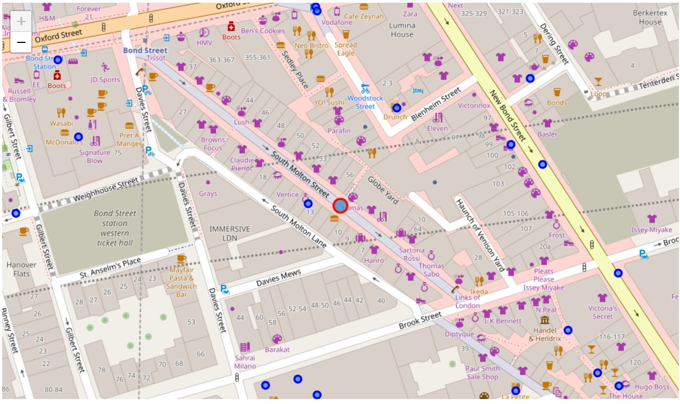
2. Criteria for the new store selection
Replication of the success the store experienced in Mayfair London by select an area in Seattle similar to the surrounding of their London Store as seen in picture below.
Figure 1: Browns Fashion Boutique in Mayfair London and surrounding venues using Folium

Slide 4
2. Criteria for the new store selection
The new store has to have in its neighborhoods at least the following 3 top venues highlighted in red. These venues represents the most common businesses in its surrounding in Mayfair London.
Art Gallery
Clothing Store
Italian Restaurant
Coffee Shop
Boutique
Juice Bar
French Restaurant
Hotel
Café
Cosmetics Shop

Slide 5
3. Methodology/Data Analysis Workflow
Data manipulation and analysis to derive subsets of the initial data
Identification of the high traffic areas using:
Segmentation of the neighbourhood through k-means clustering
Data visualisation of the clustered neighbourhood --using various mapping libraries including Geopy and folium libraries in Python (folium)
Selection of the best neighbourhood using venues frequency with the help of Violin plot library in python Results

Slide 6
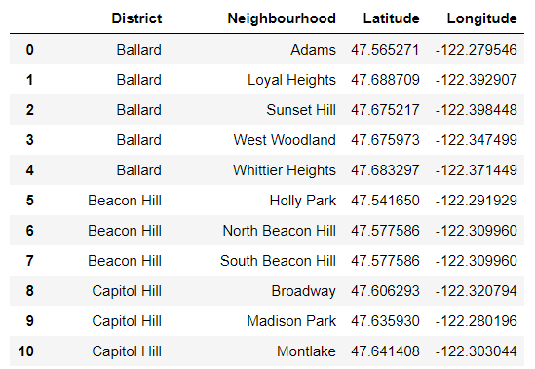
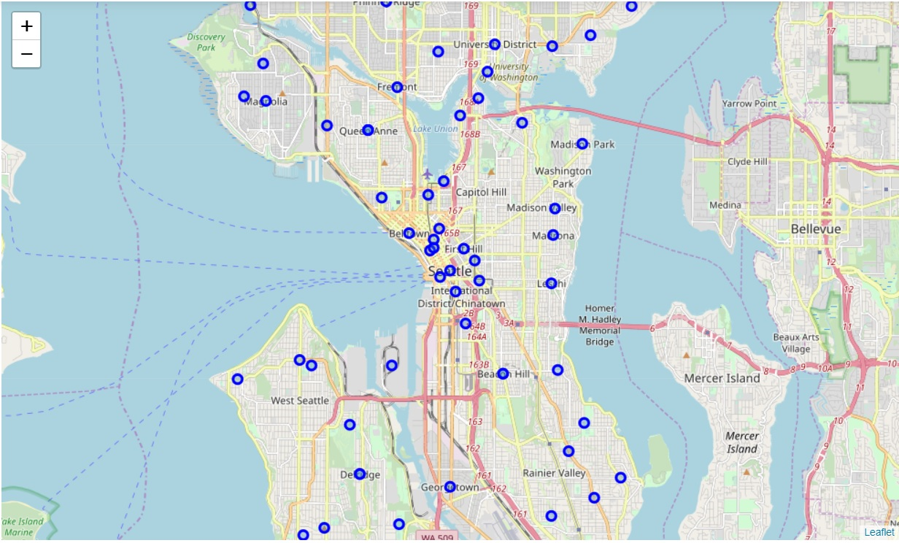
4. Data
Figure 2: Showing the DataFrame containing Seattle neighbourhood, Districts and geospatial coordinates.
Figure 2: Showing Geospatial Map of Seattle neighbourhood and Districts

Slide 7
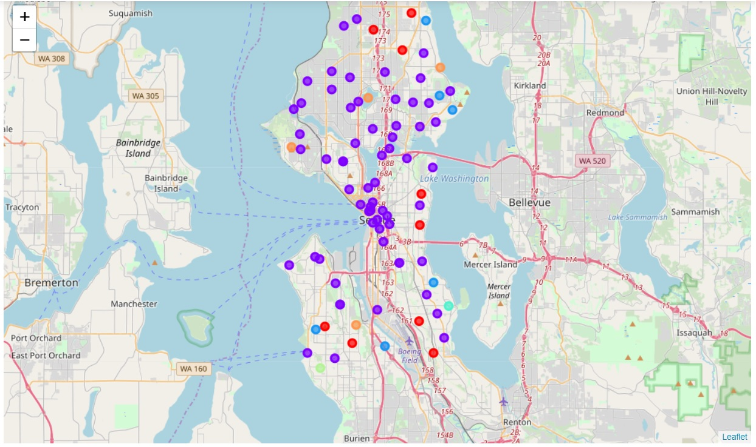
5. Exploratory Analysis (K-Means Clustering)
Figure 2: Showing Seattle neighbourhood being group in 6 different clusters based on venues found in them. Cluster 2 was selected for detailed analysis.

Slide 8
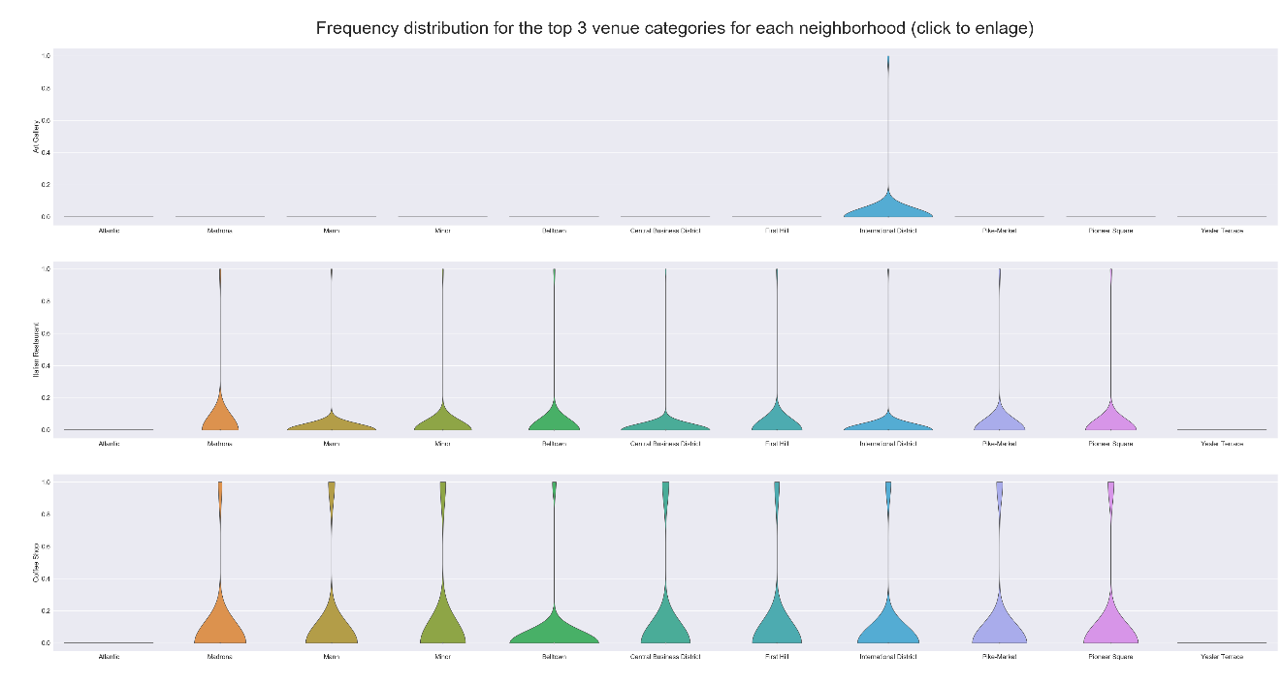
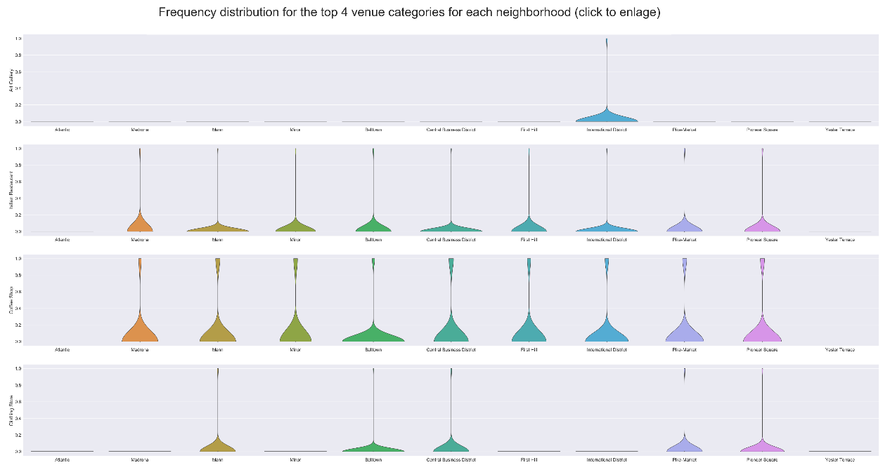
6. Results
Figure 2: Showing the best neighbourhood that meets all the 3 set criteria, 4th from right-to-left in the above 2 plots (The international District)

Slide 9
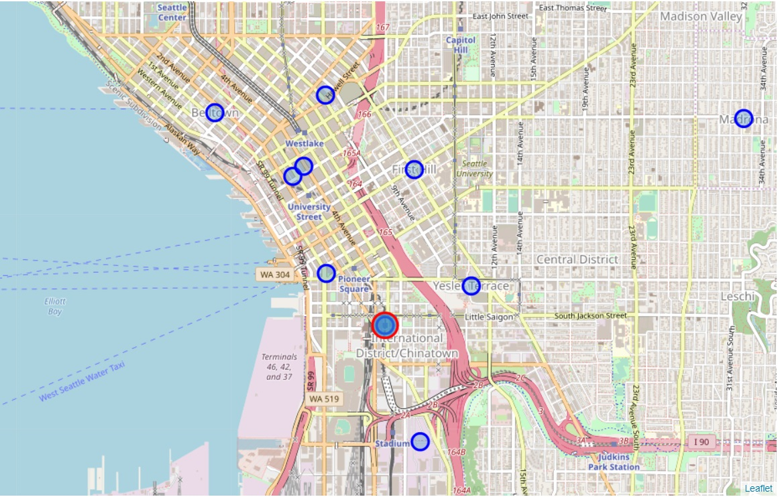
6. Results
Figure 2: Showing the The international District --the neighbourhood that meets all the 3 set criteria, circled in red on the geospatial map of Seattle

Slide 10
7. Conclusion
Inferences was made to help make a new location recommendation for a New Browns Fashion Boutique in Seattle Wa.
The work steered a course for Browns Fashion Boutique's Decision Makers to select the best possible location for their new store in Seattle, WA.
Based on the criteria of being in neighbourhoods that has at least an Art Gallery, an Italian restaurant and a Coffee Shop.
This problem could be reinforced by expanding the number of venues in.
K-means clustering was used to first group neighbourhoods from the entire Seattle, WA and then select a cluster that met most of the criteria for details analysis.
Violin Plot was used to visualise the best location of the store.
The international District neighbourhood in Seattle was selected as the best location as it met all the criteria and no competition was in proximity.

